Slide 1
Angular
Routing
Lecture 6
By James(Jin) Wang
09/01/2019

Slide 2
Outline
Defining Routes
Routing Modules
Route Parameters
Guards

Slide 3
Defining Routes
  Routing Basics:
  Routing allows our application to navigate between different Components, passing parameters where needed

Slide 4
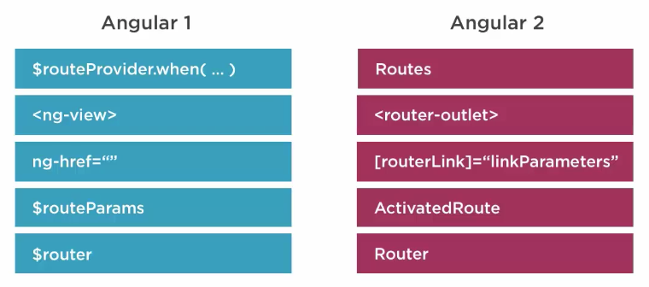
Defining Routes
  Routing then and now:

Slide 5
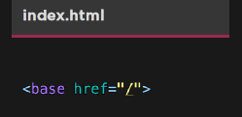
Defining Routes
  Define the <base> element:
  Required for routing to work properly

Slide 6
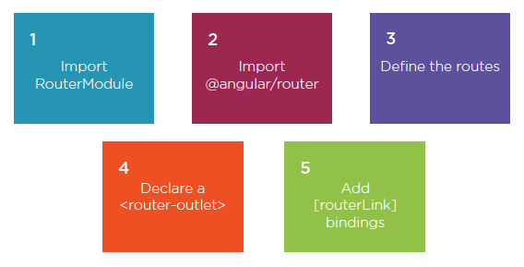
Defining Routes
  Routing Step by Step:
  Demo: Needs Router

Slide 7
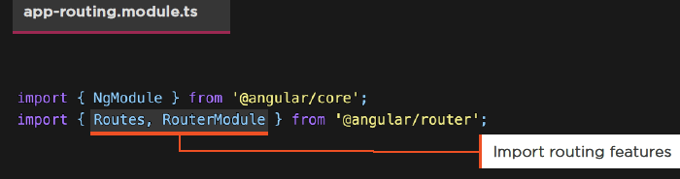
Routing Modules
  Importing RouterModule:
  RouterModule gives us access to routing features
  Routes help us declare or route definitions

Slide 8
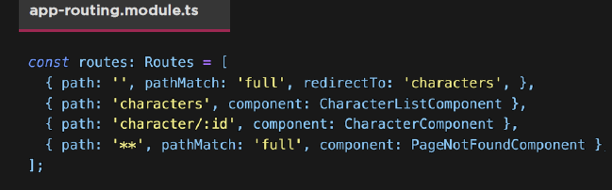
Routing Modules
  Defining Routes:
  Define the route’s path
  Indicate parameters with: Set the component that we’ll route to

Slide 9
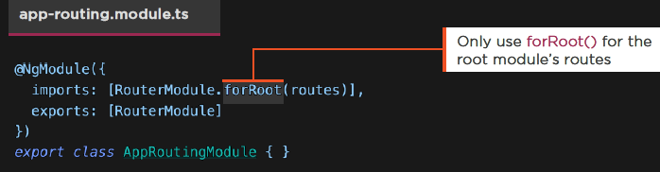
Routing Modules
  Defining a Module:
  Create a routing module using our routes, and import it
  Export our new AppRoutingModule

Slide 10
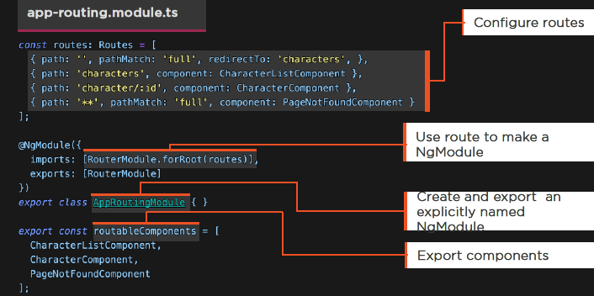
Routing Modules
  Export the Module and the Components

Slide 11
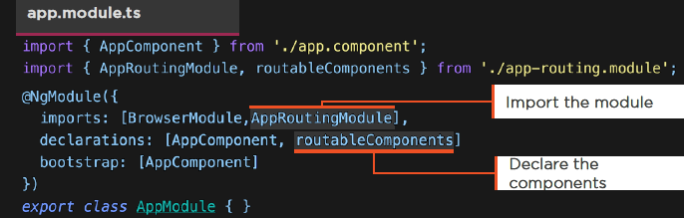
Routing Modules
  Using Our Routing Module:
  Import our routing module
  Declare the components

Slide 12
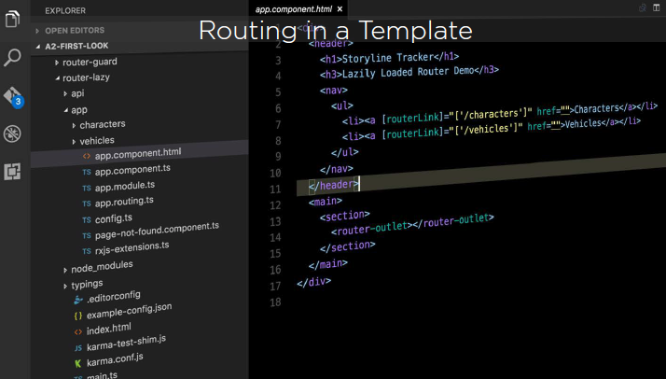
Routing Modules
  Routing in a Template:

Slide 13
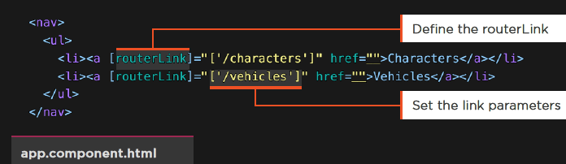
Routing Modules
  RouterLink:
  The RouterLink directive navigates to a route path
  We define the link parameters array

Slide 14
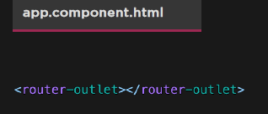
Routing Modules
  Using the RouterOutlet:
  Defines where to put the components when we route
  Demo: Router

Slide 15
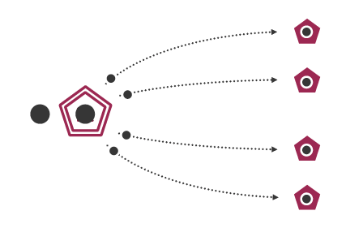
RxJS

Slide 16
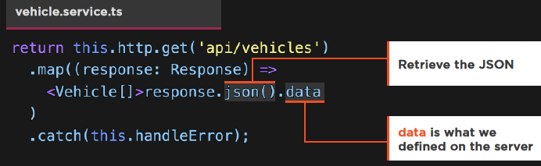
RxJS
  Returning from HTTP:
  We don’t return the response
  Service does the work
  The consumers simply get the data

Slide 17
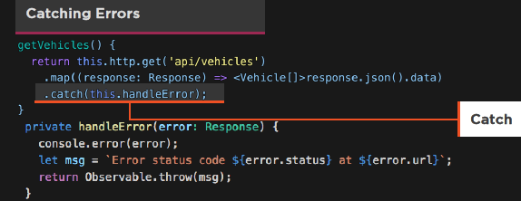
RxJS
  Exception Handling:
  We catch errors in the Service
  We pass some error messages to the consumer for presentation

Slide 18
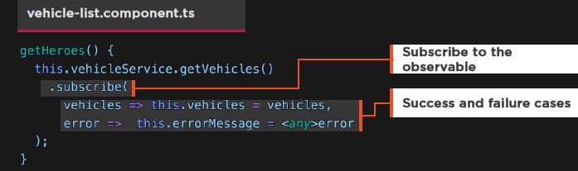
RxJS
  Subscribing to the Observable:
  Component is handed an Observable
  We Subscribe to it
  We can handle errors here, for presenting to the user if we wish

Slide 19
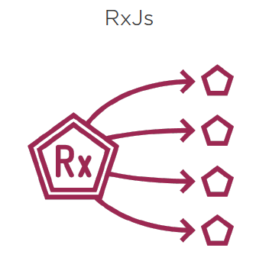
HTTP

Slide 20
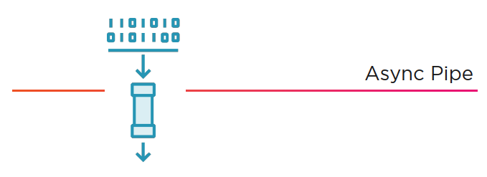
Async Pipe
  The Async Pipe receives a Promise or Observable as input and subscribes to the input, eventually emitting the values as changes arrive.

Slide 21
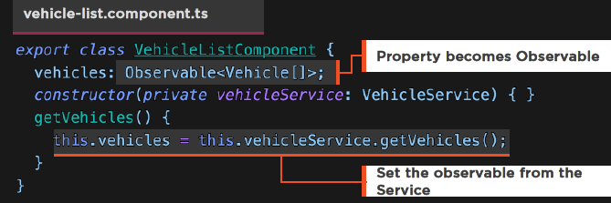
Async Pipe
  Observable Properties:
  Component is simplified
  Grab the Observable and set it to property

Slide 22
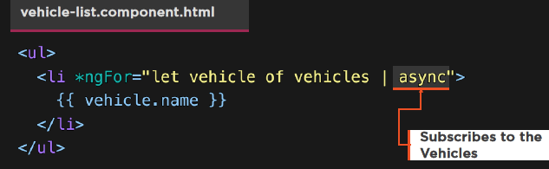
Async Pipe
  Async Pipe in the Template:
  Apply the async Pipe
  Demo: HTTP
  Demo: HTTP with Promise
  Demo: HTTP with Async Pipe

Slide 23
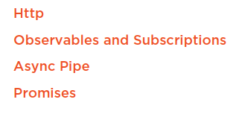
Summary

